Slide 1

SQL vs NoSQL for Online Stores: A Comparative Study
This presentation explores the key differences between SQL and NoSQL databases, highlighting their strengths and weaknesses for online store applications.
Presented by: Ilyas Sayh
Supervised by: Mr. Mohamed Amine TALHAOUI

Slide 2
Introduction
Data Model: Rigid vs. Flexible Structure
Querying: Structured vs Flexible
Examples of querying: SQL and NoSQL USING MY USE CASE(online store)
Scalability: Horizontal vs. Vertical
Use case
conclusion

Slide 3


Introduction: Key Definitions and Differences
SQL: Structured Query Language
Relational databases, structured data, table-based, ACID properties (Atomicity, Consistency, Isolation, Durability). Examples: MySQL, PostgreSQL, Oracle.
NoSQL: Not Only SQL
Non-relational databases, unstructured or semi-structured data, flexible schemas, eventual consistency.
Examples: MongoDB, Cassandra, Redis.
1

Slide 4

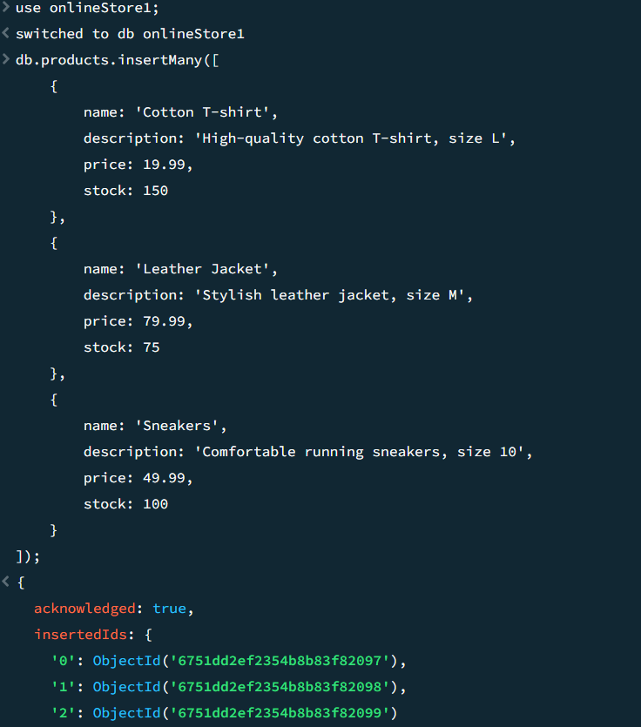

Data Model: Rigid vs Flexible Structure
SQL
NoSQL
Rigid, predefined schema. Data organized in tables with rows and columns. Ideal for consistent data integrity and predictable queries.
Flexible, schema-less or dynamic schema. Data can be stored in documents, key-value pairs, or graphs. Adaptable to evolving data structures.

Slide 5


Querying: Structured vs Flexible
NoSQL
SQL
Structured Queries (SQL)
DEFINITION: SQL uses structured queries to retrieve data from predefined tables. Data is queried using the Structured Query Language (SQL), which operates on a fixed schema.
Key Characteristics :
Fixed Schema: Data must adhere to a predefined schema (tables with specific columns and data types)
Complex Queries: Supports JOINs for combining multiple tables, GROUP BY, aggregations, and more.
ACID Compliance: Guarantees data integrity for complex transactions.
2. Flexible Queries (NoSQL)
DEFINITION: NoSQL queries work on schema-less or flexible schemas, meaning the structure of the data can change over time without requiring a predefined schema.
Key Characteristics:
No Fixed Schema: NoSQL allows for unstructured data storage (documents, key-value pairs, etc.).
Simple Queries: Typically optimized for fast reads and writes. Queries are often simpler, but may lack the complexity of relational queries.
Horizontal Scaling: NoSQL is designed to scale horizontally, handling large volumes of data across many servers.
3

Slide 6
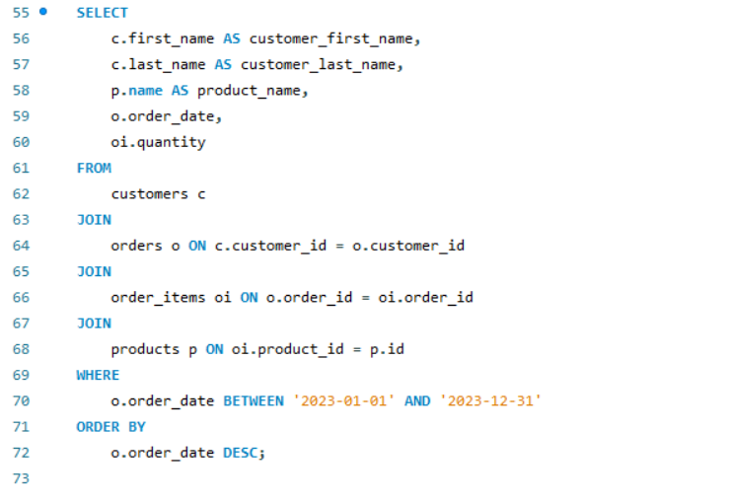
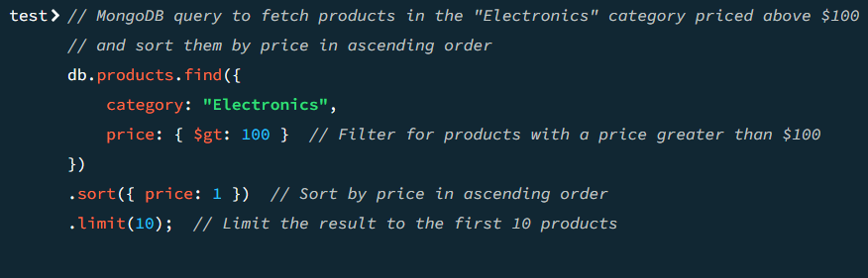
Examples of querying: SQL and NoSQL USING MY USE CASE(online store)
SENARIO : You want to retrieve a list of customers who have made orders in the past year, along with the names of the products they ordered, the order date, and the quantity.
NoSQL
SQL
SENARIO : Let’s say you want to retrieve products in the "Electronics" category that are priced above $100, and you also want to limit the results to the first 10 products. You store products in a MongoDB collection, where each product is a document in a collection called products.
4

Slide 7
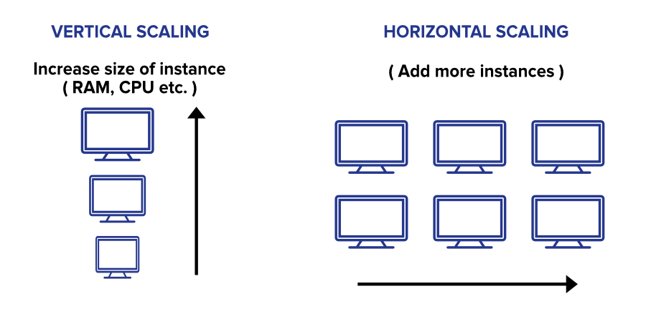
Scalability: Horizontal vs. Vertical
Vertical Scaling (SQL)
Horizontal Scaling (NoSQL)
Vertical scaling ("scaling up") increases a single server's power. Simple initially, but limited and creates a single point of failure.
Horizontal scaling distributes the database across multiple servers, managing large datasets and high traffic effectively. Adding servers is easy, ensuring high availability, though management complexity increases.
Server failure or capacity limits impact the entire system. While easier to implement, it's unsuitable for high growth or high availability needs.
5

Slide 8
Use Cases: The Online Store
1
Product Catalog
SQL: structured data, reliable and consistent for managing product information.
2
User Profiles
NoSQL: flexible schema, can handle complex and varied user data.
3
Order Processing
SQL: transactional consistency, critical for handling financial transactions.
4
Customer Feedback
NoSQL: unstructured data, ideal for storing text reviews, images, and videos.
6

Slide 9
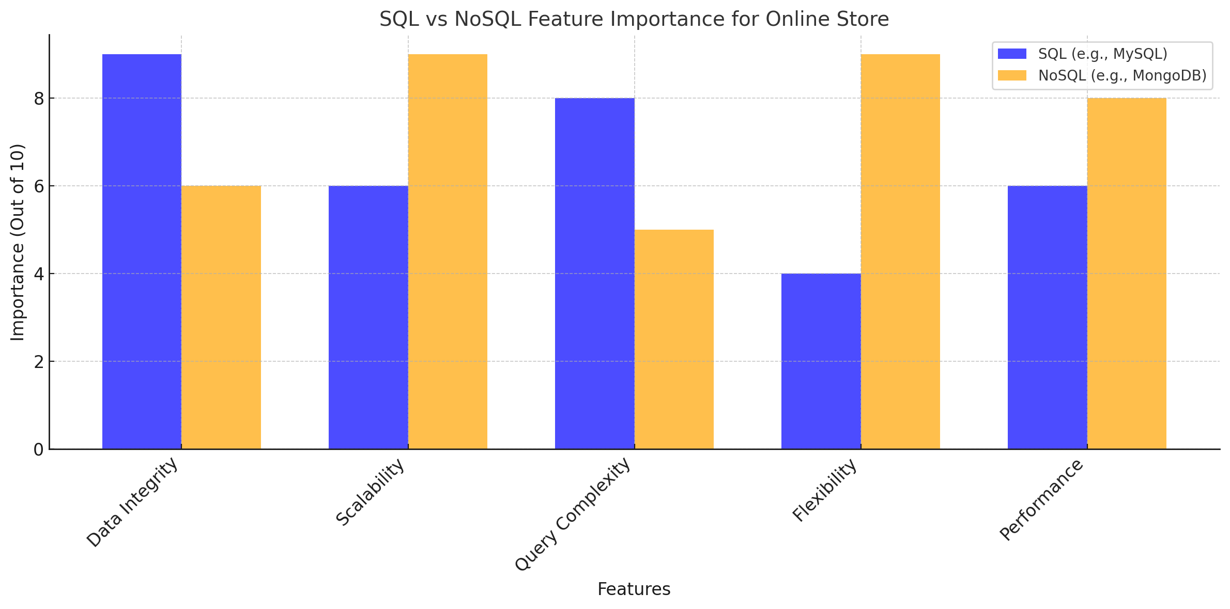
IN MY USE CASE WICH IS ONLINE STORE I FIND THAT :
8

Slide 10
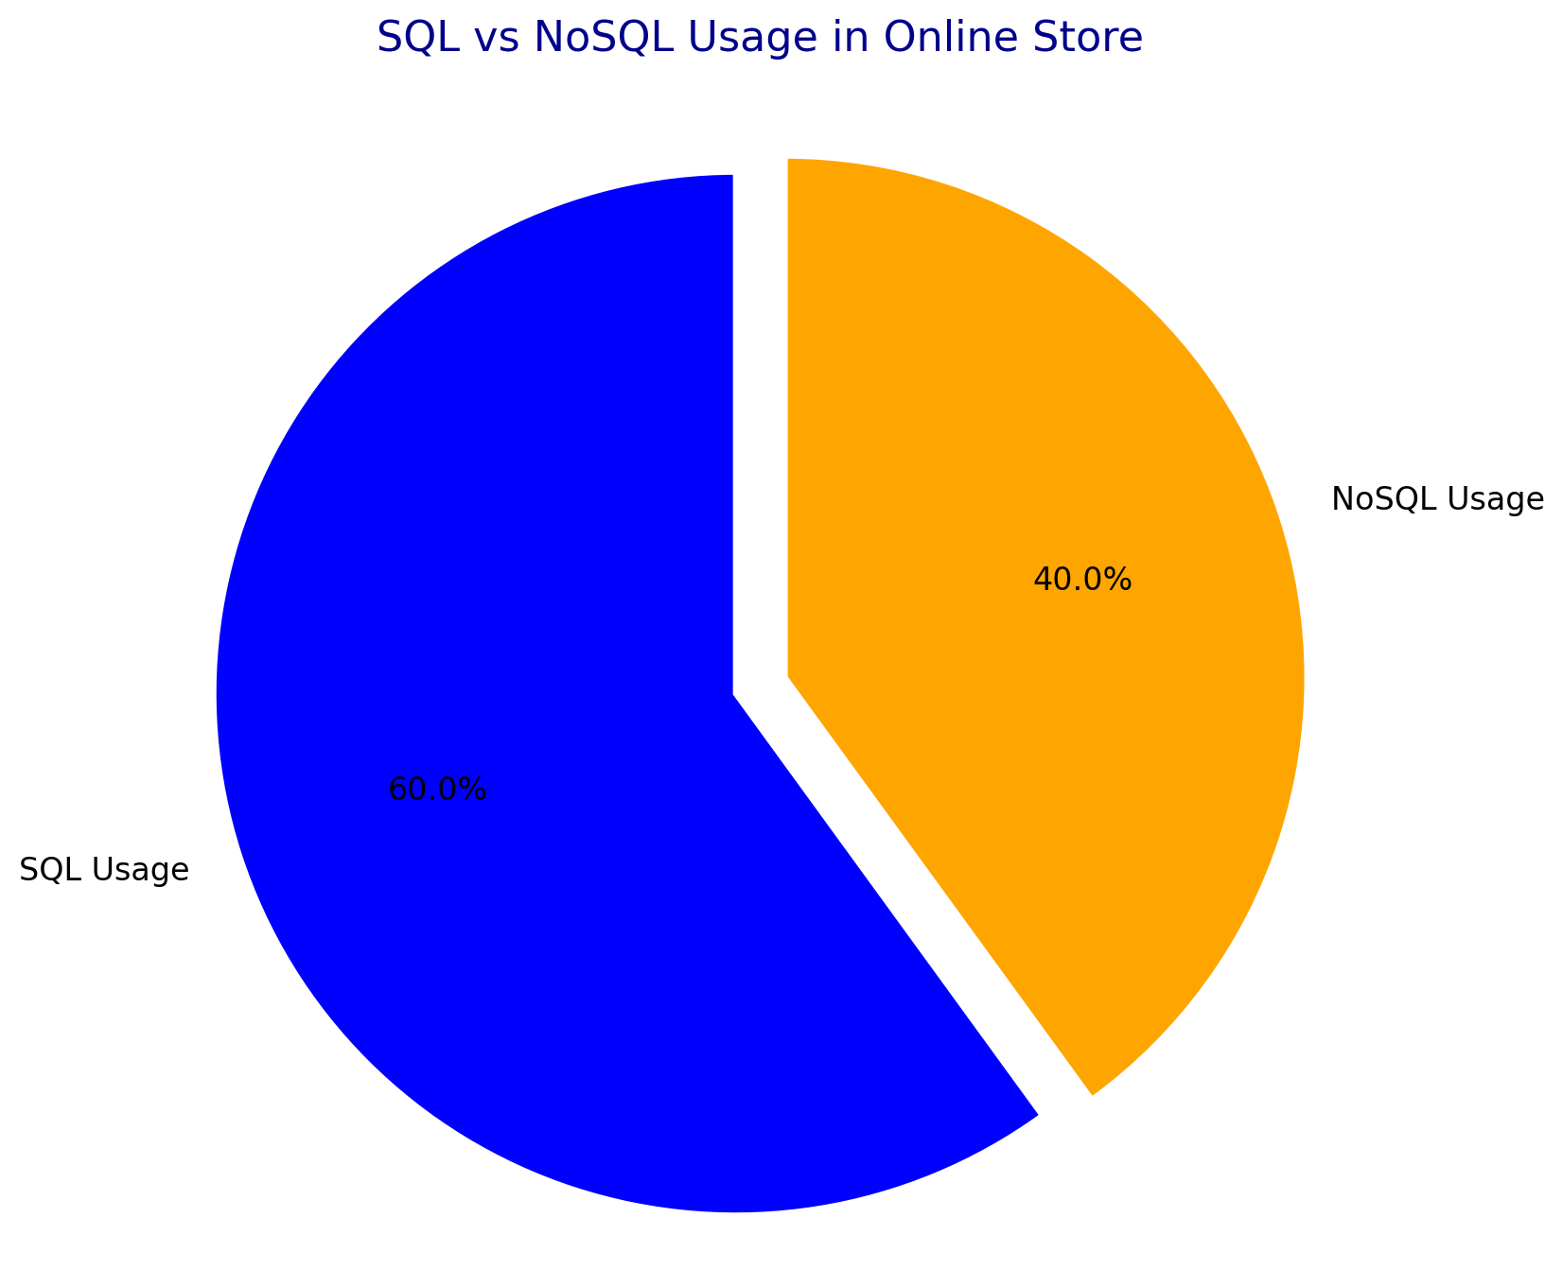
AND FOR MY USE CAS I USE :
9

Slide 11

Conclusion: Choose Wisely
1
Scalability
NoSQL excels in scaling out to handle massive user traffic.
2
Flexibility
NoSQL offers adaptable data models for evolving online store needs.
3
Performance
SQL remains a strong choice for consistent data integrity and analytical tasks.
10

Slide 12


